Slide 1
All About OSAP
Ontario Student Assistance Program
Zoe Abell

Slide 2
Learn about the OSAP program
How to submit your application
Maximize your funding

Slide 3
Poll: Have you submitted an OSAP application before?
Notes:
Pull up “OSAP Before or Not” poll

Slide 4
Learn about the OSAP program

Slide 5
What is OSAP?
The Ontario Student Assistance Program (OSAP) is a financial aid program that can help you pay for college or university.
Grants: money you don’t have to pay back
Student loans: money you need to repay once you’re done school
Notes:
You are automatically considered for grants and loans as part of your application. Federal loans are forever interest free, and provincial loans are prime +1%. You don’t begin paying until six months after you are last enrolled full time. There are also repayment assistance programs that you can access if you are unable to make the expected payment.

Slide 6
What OSAP can help with
OSAP can help you pay for:
Tuition
Books and equipment
Fees charged by the school
Living expenses (full-time students only)
Child care (for full-time and part-time students with children)

Slide 7
Who can get OSAP
OSAP is open to Ontario residents of any age who are:
Canadian citizens
Permanent residents
Protected persons
And:
Enrolled in or entering an OSAP-approved program and school

Slide 8
Who is not eligible
You may not be eligible for OSAP if You:
Don’t meet the academic progress requirements
Have enough financial resources to cover your expenses (includes other government aid)
Your reported income is significantly different than what you reported to the CRA
Have defaulted on a student loan
Have an overpayment
Failed a credit check
Filed for bankruptcy, made a consumer proposal, obtained a consolidation order, or filed a document seeking relief for the orderly payment of debts
Have reached your lifetime limit of student loan funding
Are an international student
Are not a resident of Ontario
Notes:
Students receiving social assistance should be reporting the amount they are receiving on OSAP app, and letting their caseworker know how much OSAP they receive

Slide 9
How much you can get
Education expenses
Course load
Personal financial situation
Money needed for tuition, books, child care, personal living expenses, supplies and equipment
Full-time vs. Part-time student
Based on you and your family’s income, family size, dependents and other factors
Notes:
Amount depends on:

Slide 10
How is your funding calculated
Educational Costs
Tuition
Books and equipment
Living Expenses
Child care
Financial Contribution
Family income
Employment income (up to $5,600 per term before impact)
Assets
Scholarships and bursaries
Government income
Financial Need

Slide 11
Course load
A minimum of 60% (40% for students with disabilities) of a course load is required to be full-time. 20-59% is considered part-time.
Full-time:
9 credits per semester (6 credits for students with disabilities)
Credits cannot be averaged across semesters
Part-time:
3-6 credits per semester
Students with disabilities between 40-59% course load can choose between part-time and full-time application

Slide 12
Student status
Most students are divided into two categories
Dependent:
Not married or common-law
Not separated, divorced or widowed
Not a sole-support parent
You have been out of high school for less than six years (four years for the Federal side)
You have not worked full-time for at least 24 months in a row
Dependent students must report their parents’ income on their application
Independent:
You have been out of high school for at least six years (four years for the Federal side)
You have worked full-time for at least 24 months in a row
Both of your parents are deceased
You are currently receiving allowance from the Children’s Aid Society
You are not married or common-law
You do not have any dependent children
Notes:
Students who are out of school for 4 years and do not wish to provide their parental information, may choose to be assessed for Federal funding only.

Slide 13
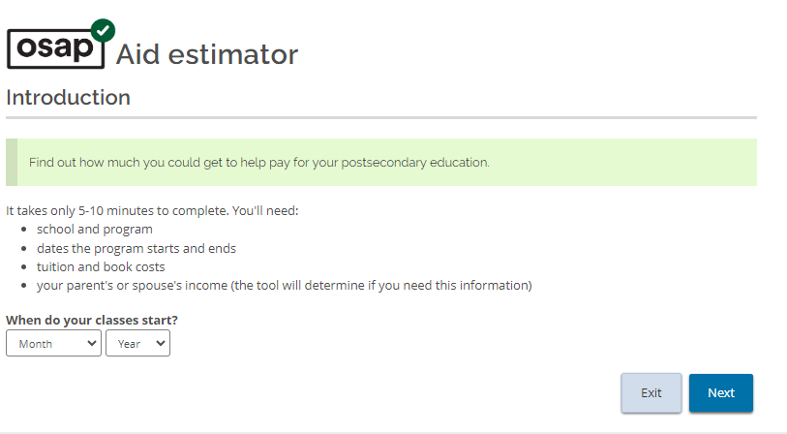
Aid Estimator

Slide 14
How to submit your application

Slide 15
Application deadlines
Full-time students
60 days before the end of your study period
Part-time students
Study period of 21 weeks or more:
60 days before the end of your study period
Study period of 20 weeks or less:
40 days before the end of your study period
Apply by June 30th to have your fee deadlines deferred in September and January
Full-time and Part-time:
All documents must be submitted no later than 40 days before the end of your study period

Slide 16
What will you need to apply?
Social Insurance Number
Information about your school and program
Your parents’ or spouse’s SINs and information (if applicable)
Your parents’ or spouse’s tax information from 2022 (if applicable)
You do not need to be enrolled to submit your OSAP application

Slide 17
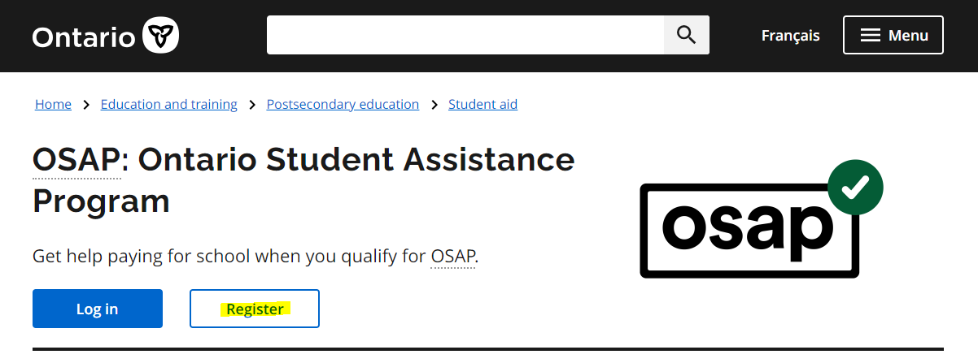
ontario.ca/osap

Slide 18
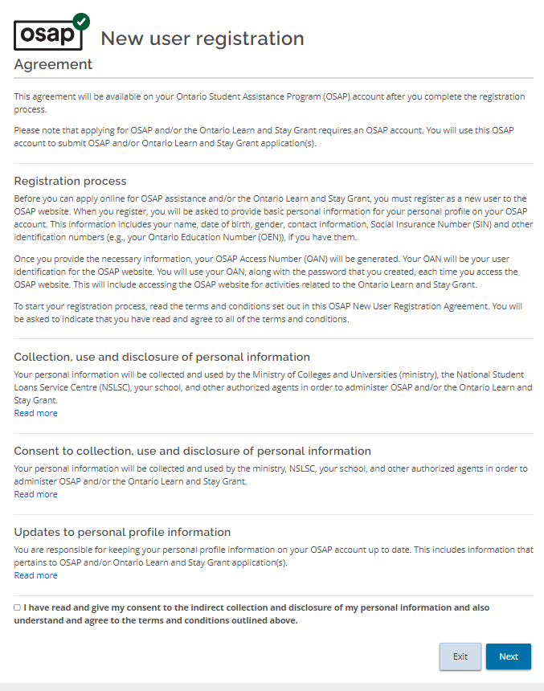

Slide 19
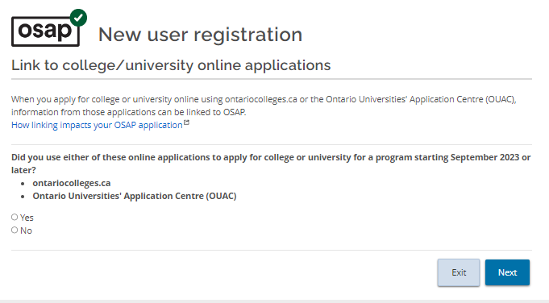

Slide 20
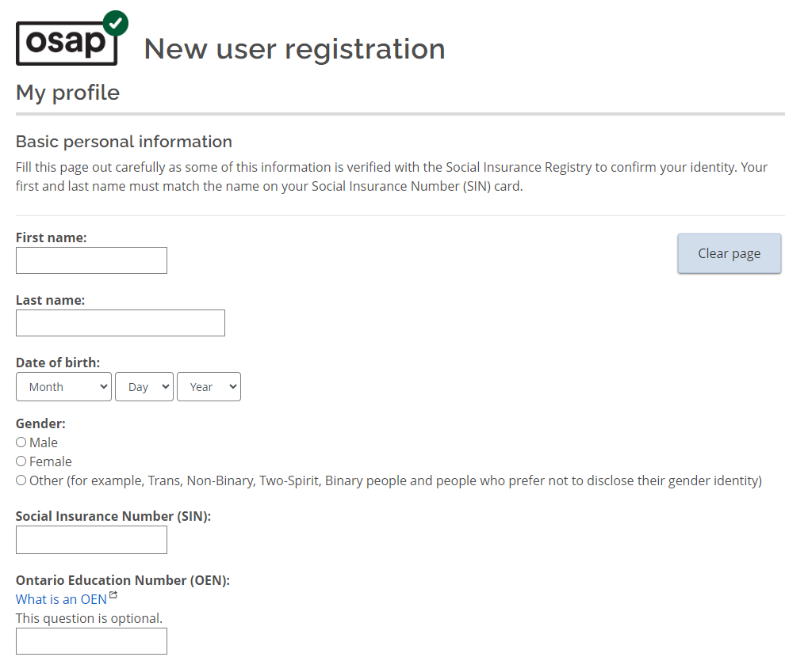
Must be your name as it appears on your SIN card/confirmation page

Slide 21
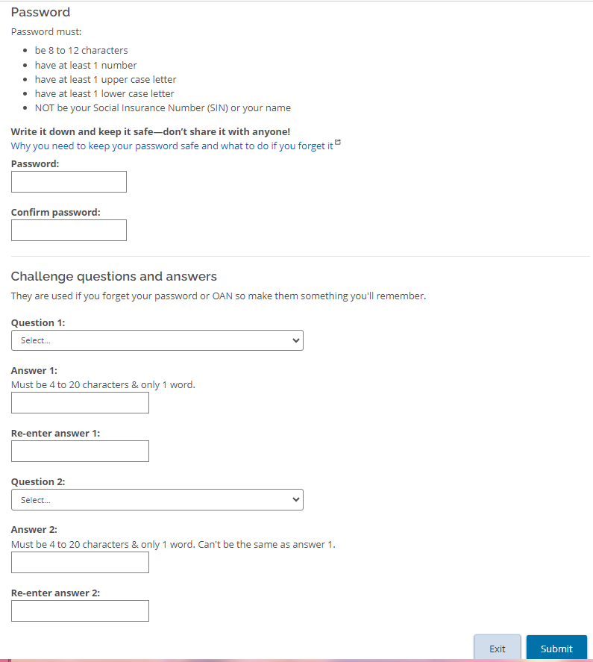

Slide 23
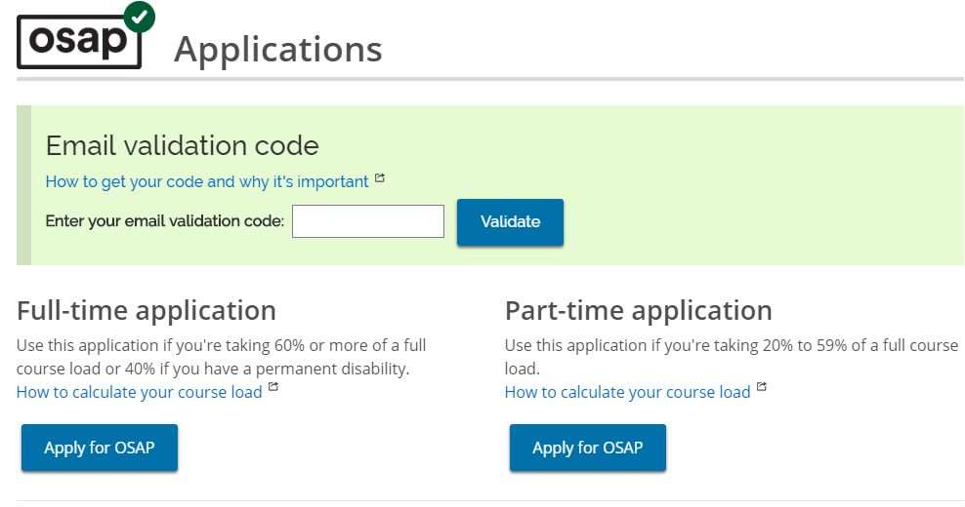

Slide 24
Students with disabilities
If you have a permanent disability or a persistent or prolonged disability, you benefit from:
Reduced course load
Canada Student Grant for Students with Disabilities (if additional criteria are met)
Access to the Bursary for Students with Disabilities and the Canada Student Grant for Services and Equipment for Students with Disabilities
Self-identification and documentation is required

Slide 25
Submit the application

Slide 26
Submit your documents
Upload your documents directly to your OSAP application
Everyone
Signature pages
Master Student Financial Assistance Agreement (MSFAA)
Depending on your situation
History of Canadian residency
Proof of SIN
Child birth certificates
Marriage certificate
Etc

Slide 27
After you apply
Grant Only Funding
Confirmation of enrolment
Report any changes!
Academic Probation
Income Taxes
You do not have to accept the loans – see assessment page.
Your funds are released in September and January after the school confirms you are enrolled.
Course load, finances, status, all must be reported – overpayment could occur.
If you do not pass full-time course load, probation and further restrictions could occur
OSAP is not income, do not claim it on your taxes.
Notes:
Amount depends on:

Slide 28
Maximize your funding

Slide 29
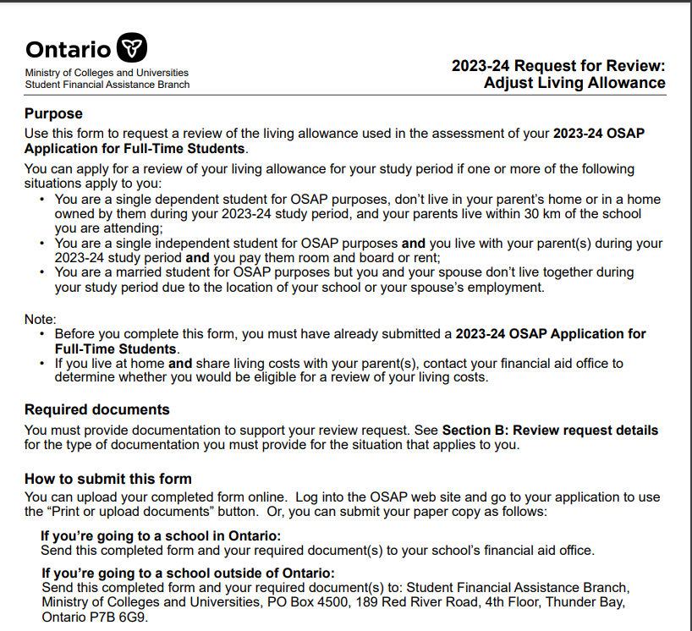
OSAP Appeals
Estimated Income Reviews
Exceptional Family Situations
Living Away from Home Allowance
Additional Travel Allowance

Slide 30
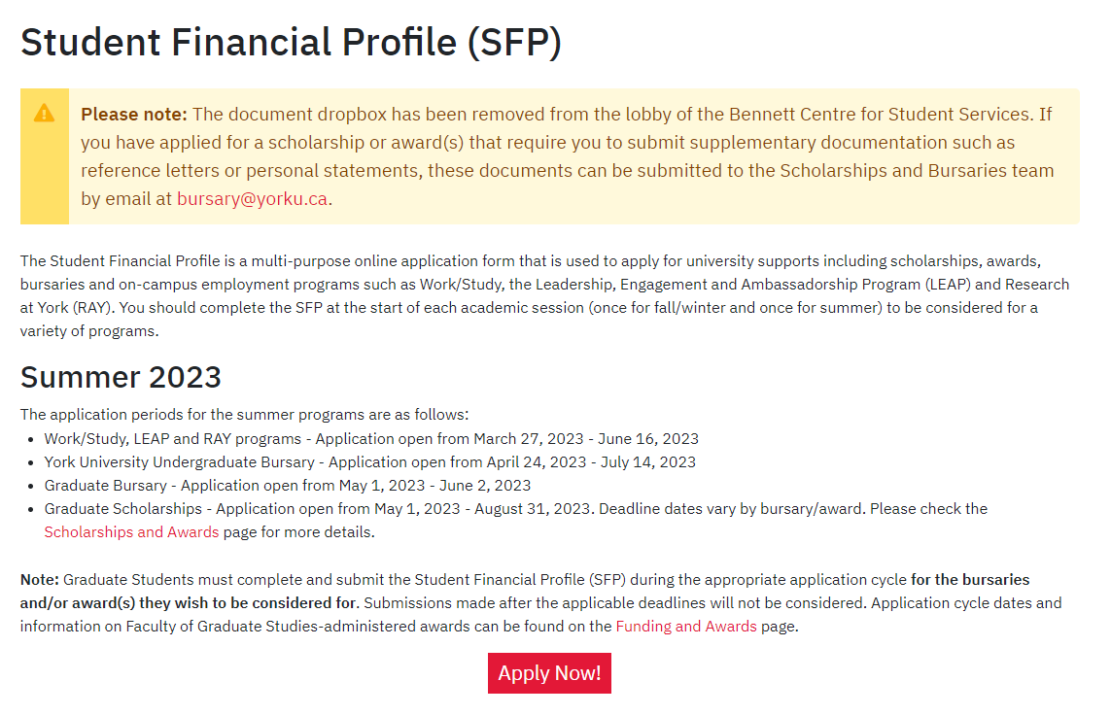
Submit the Student Financial Profile

Slide 31
Contacts
Glendon Student Financial Services
York Hall C138
finance@glendon.yorku.ca
416-487-6701
www.glendon.yorku.ca/sfs
National Student Loan Service Centre (NSLSC)
Chat bot
Email form
1-888-815-4514
www.csnpe-nslsc.canada.ca

Slide 32
Q&A

